Slide 1
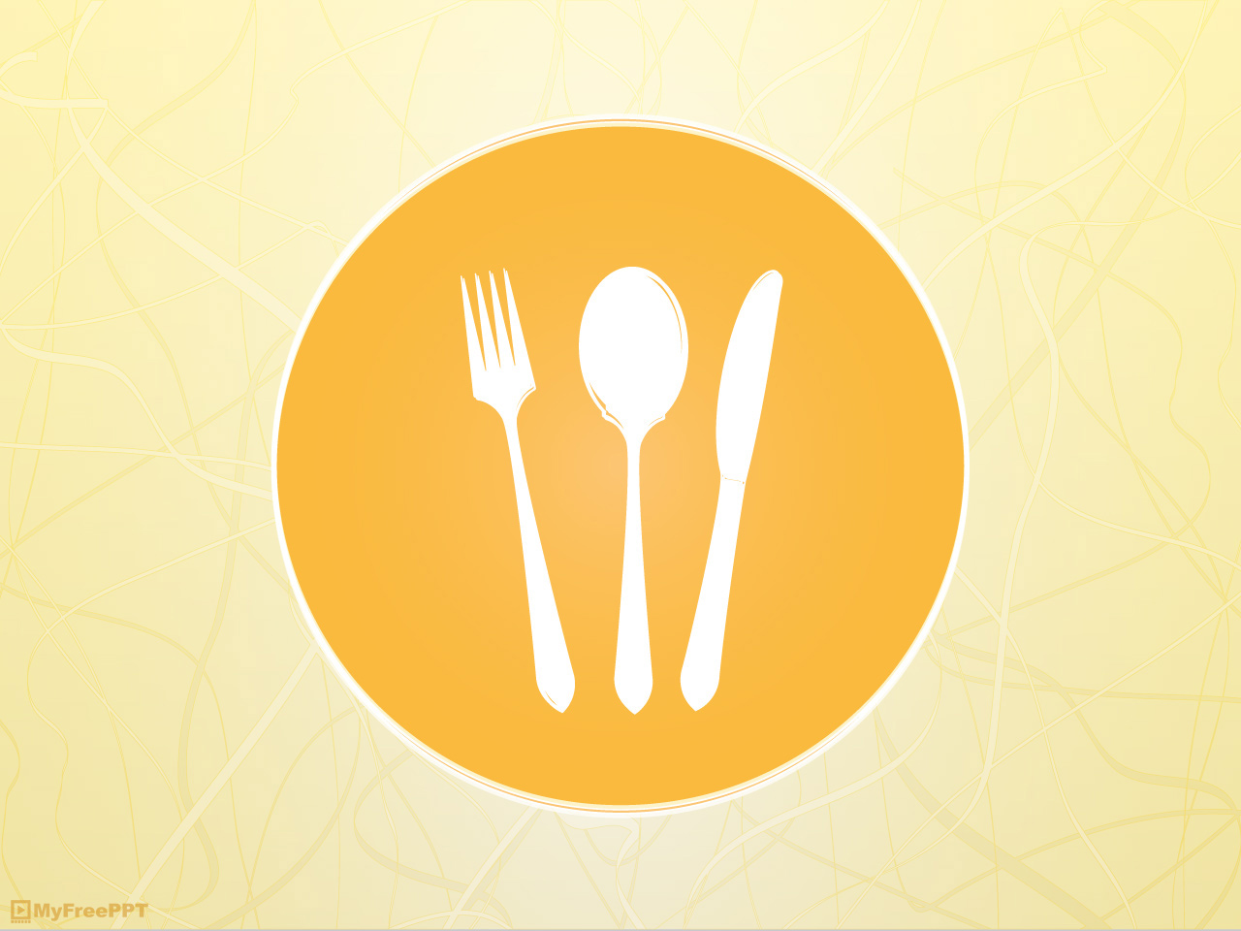

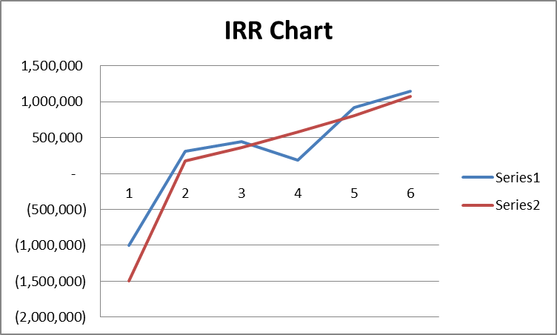
Muhammad Jaza (60613)
Shafaq Aftab (60982)
Tania Jatoi (60730)
Course: Introduction to Business And Finance.
Instructer: Arsalan Hashmi
INTRODUCTION:
We are gearing up to create the world's first mass produced edible cutlery. This has huge potential to prevent plastic waste.
OBJECTIVES:
Create awareness on edible cutlery alternative to plastic cutlery.
Make available Edible cutlery worldwide and provide direct market to farmers.
Help farmers to grow millet as we will be their direct buyers
Providing nutrition through spoons that one can eat after eating food with it (no wastage, no garbage left behind, no need to wash).
ABOUT US:
Our ingredients are as simple with absolutely no preservatives. The lack of water, moisture, or fat in our product allows it to have a long shelf life without the need for extra preservatives.
They include: sorghum flour, rice flour, and wheat flour. bio-degradable spoons are flavored with some of India’s favorite spices: ginger-cinnamon, ginger-garlic, cumin, celery, black pepper, mint-ginger, and carrot-beet. There is also a sugar option for those who crave sweets

